Slide 1


Why You May Know The Bible
Reasons
is the WORD of GOD
(part 3c)
2 Peter 1:19-21

Slide 2

Previously:
Unity of writers
Scientific Accuracy
  Microbiology; Space Science; Earth Science
Historical Accuracy
  3a) Evidence for the Flood; prophecy of what unbelievers believe (2 Peter 3)
  3b) Prophecy of why unbelievers believe what they do (2 Peter 3)

Slide 3


Hittites (Gen. 15:20)
  Critics challenged that the Hittites
  “… were an invention of biblical editors during a supposed lengthy evolution of various books of the Old Testament”
  (G. Frederick Owen’s Archaeological Supplement, The Thompson Chain-Reference Study Bible. p. 2183. © 1997)

Slide 4
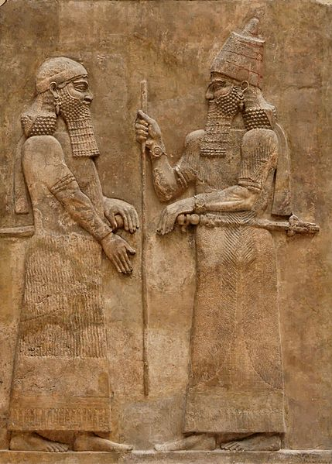
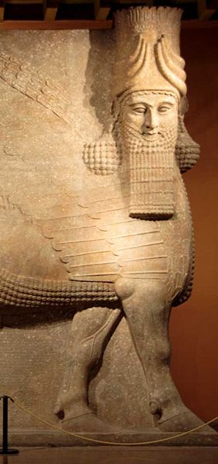
“SARGON”
(Is. 20:1)
  Critics, “no such king lived.”
  His palace was discovered (~1842)
  “The city had not been completed when Sargon died in 705 B.C. His son and successor, Sennacherib, moved the capital to the old established city of Nineveh, about 15 miles to the south, and Dur-Sharrukin appears to have been largely abandoned” (The Oriental Institute, “Discoveries at Khorsabad,” www.oi.uchicago.edu/research/projects/kho/)
Wikimedia Commons
Wikimedia Commons

Slide 5
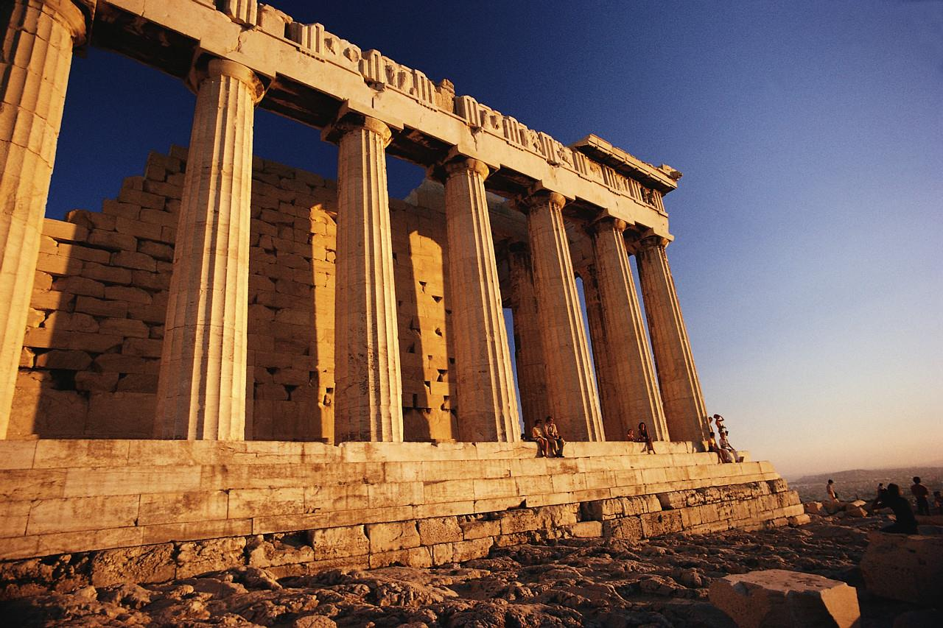
  Accuracy Of OBSOLETE TITLES
  (2 Kin. 18:17)
  “Tartan,” “Rabsaris,” “Rabshakeh”
  Assyrians disappeared from history after the battle of Carchemish in 605 A.D.
    Meaning of these words disappeared
    Meaning unknown to K.J.V. translators of 1611

Slide 6
  Accuracy Of OBSOLETE TITLES
  (2 Kin. 18:17)
  “Tartan,” “Rabsaris,” “Rabshakeh”
Commander in Chief
Chief
Eunuch
Chief of
Staff
POINT: The use of such names places the author of the book during the time when the names were used
supports their being “eye-witnesses”
validates the dating of the book
validates the genuine quality of the prophecies within the book!

Slide 7

In 4th year rebelled against the king of Assyria (2 Kin. 18:7)
In 14th year Sennacherib came against Judah and took all the fortified cities (2 Kin. 18:13)
Recognized error and paid gold and silver
(2 Kin. 18:14)
Assyrians did not turn back
  Ridiculed Egypt, Hezekiah, and Jehovah (2 Kin. 18:17-37)
  185,000 Assyrian soldiers died in one night by one angel
  (2 Kin. 19:35, 36)
  Jerusalem was not taken!

Slide 8
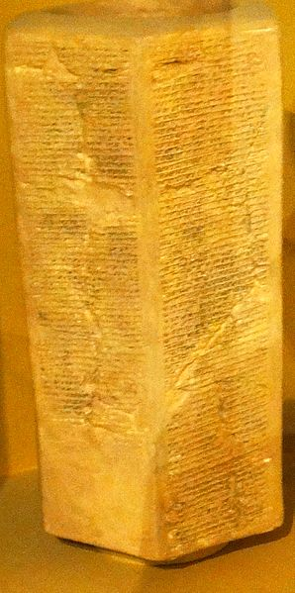
Taylor Prism
“Hezekiah himself I shut up in Jerusalem, his capital city, like a bird in a cage, building towers round the city to hem him in, and raising banks of earth against the gates, so as to prevent escape.”

Slide 9

The Bible’s Accuracy
Does not fail under true scientific scrutiny
Is actually further confirmed
Meaning is often enhanced with discoveries
“Truth shall spring out of the earth, And righteousness shall look down from heaven”
(Ps. 85:11)
Archaeology

Slide 10
The Bible’s Accuracy
“for prophecy never came by the will of man, but holy men of God spoke as they were moved by the Holy Spirit” (2 Pet. 1:21)
“Archaeology has confirmed countless passages which had been rejected by critics as unhistorical or contrary to known facts” (Joseph Free, 1969. Archaeology and Bible History. p. 1.)
Archaeology

Slide 11
The Bible’s Accuracy
“for prophecy never came by the will of man, but holy men of God spoke as they were moved by the Holy Spirit” (2 Pet. 1:21)
Confirms Bible history
Additional detail
  (Customs, meaning of words, background info.)
Demonstrates Bible prophecies
Archaeology

Slide 12


GOSPEL
HISTORY
HISTORY
Luke 3:23-38
  a listing of real historical men back to the creation
Jesus and Adam’s history are tied
  1 Cor. 15:21, 22, 45; Rom. 5:12-17
If OT history is false, then why expect the gospel to be true?
Bible history should be defended by the church today instead of compromised

Slide 13
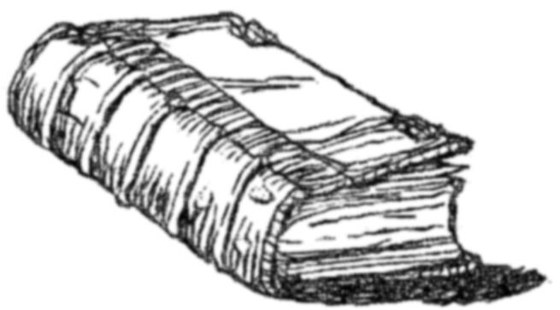
4 But when the fullness of the time had come, God sent forth His Son, born of a woman, born under the law,
5 to redeem those who were under the law, that we might receive the adoption as sons.
6 And because you are sons, God has sent forth the Spirit of His Son into your hearts, crying out, "Abba, Father!"
7 Therefore you are no longer a slave but a son, and if a son, then an heir of God
Galatians 4:4-7

